Slide 1
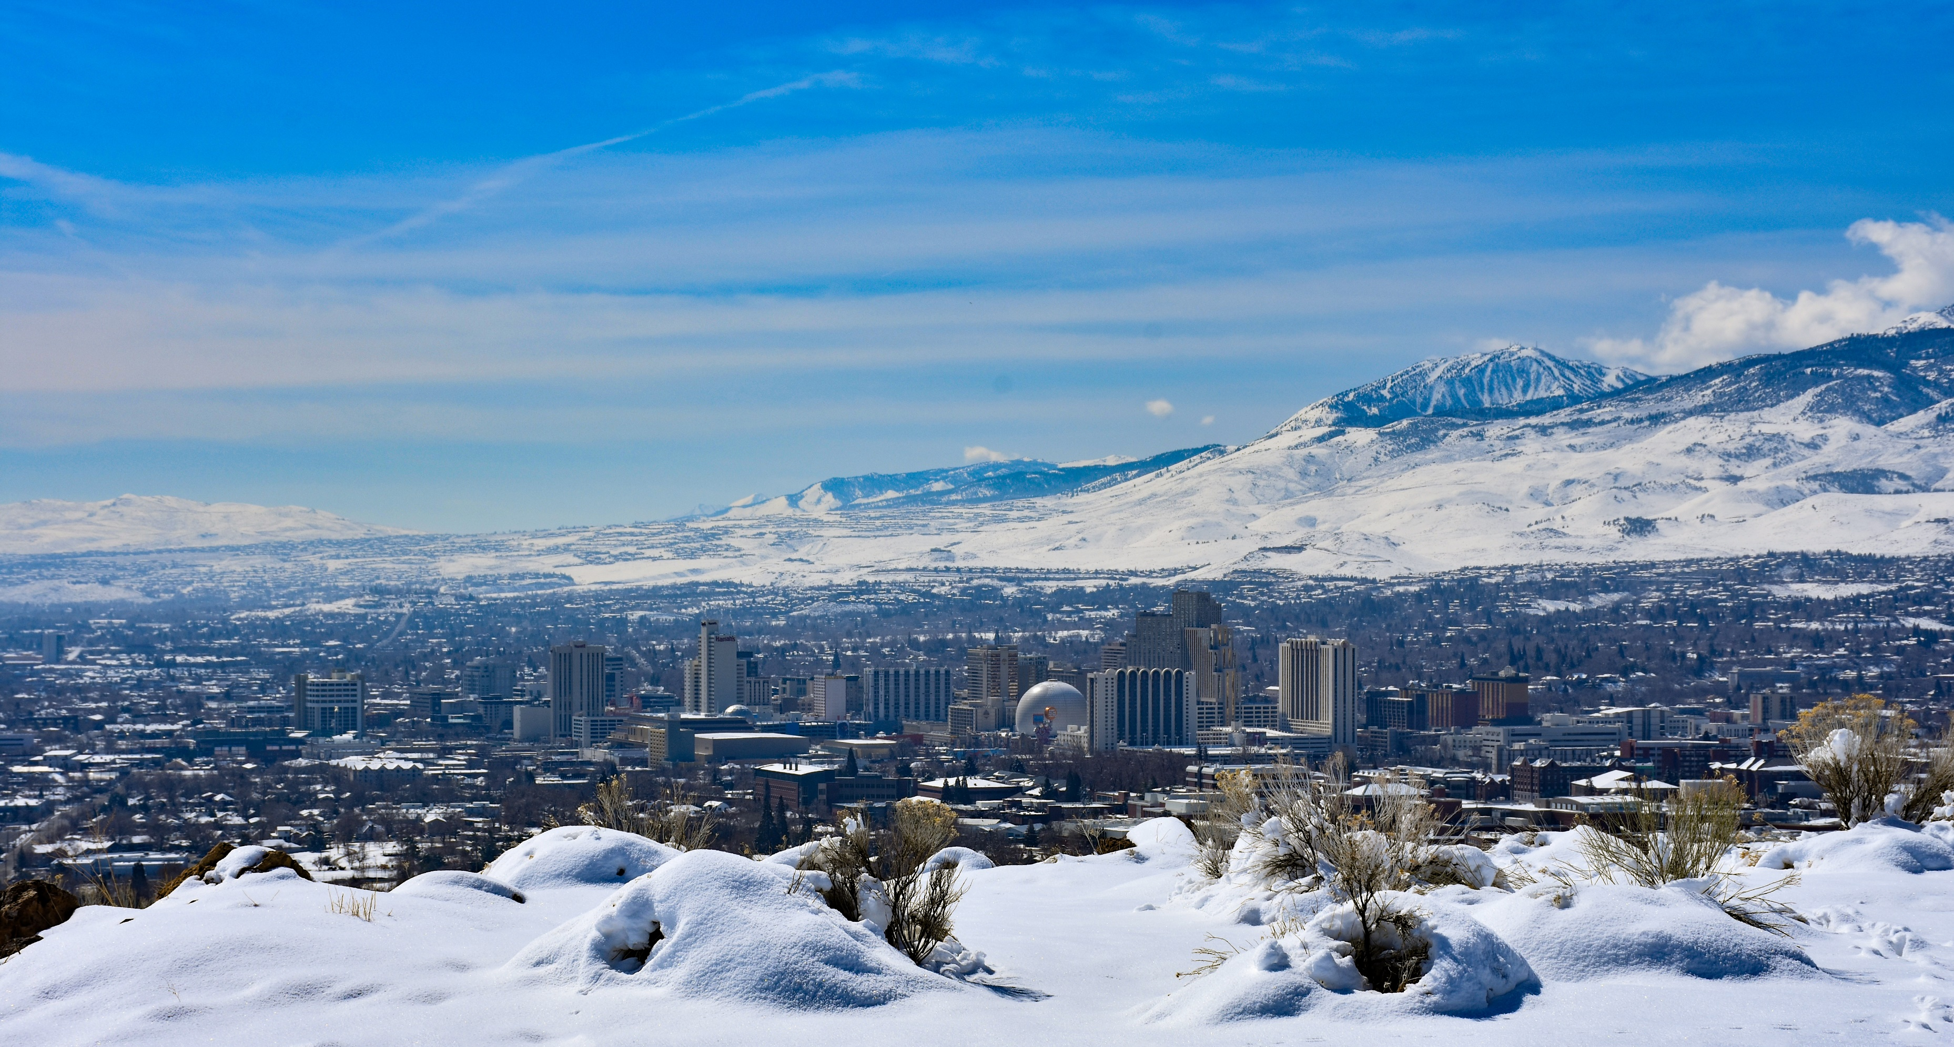
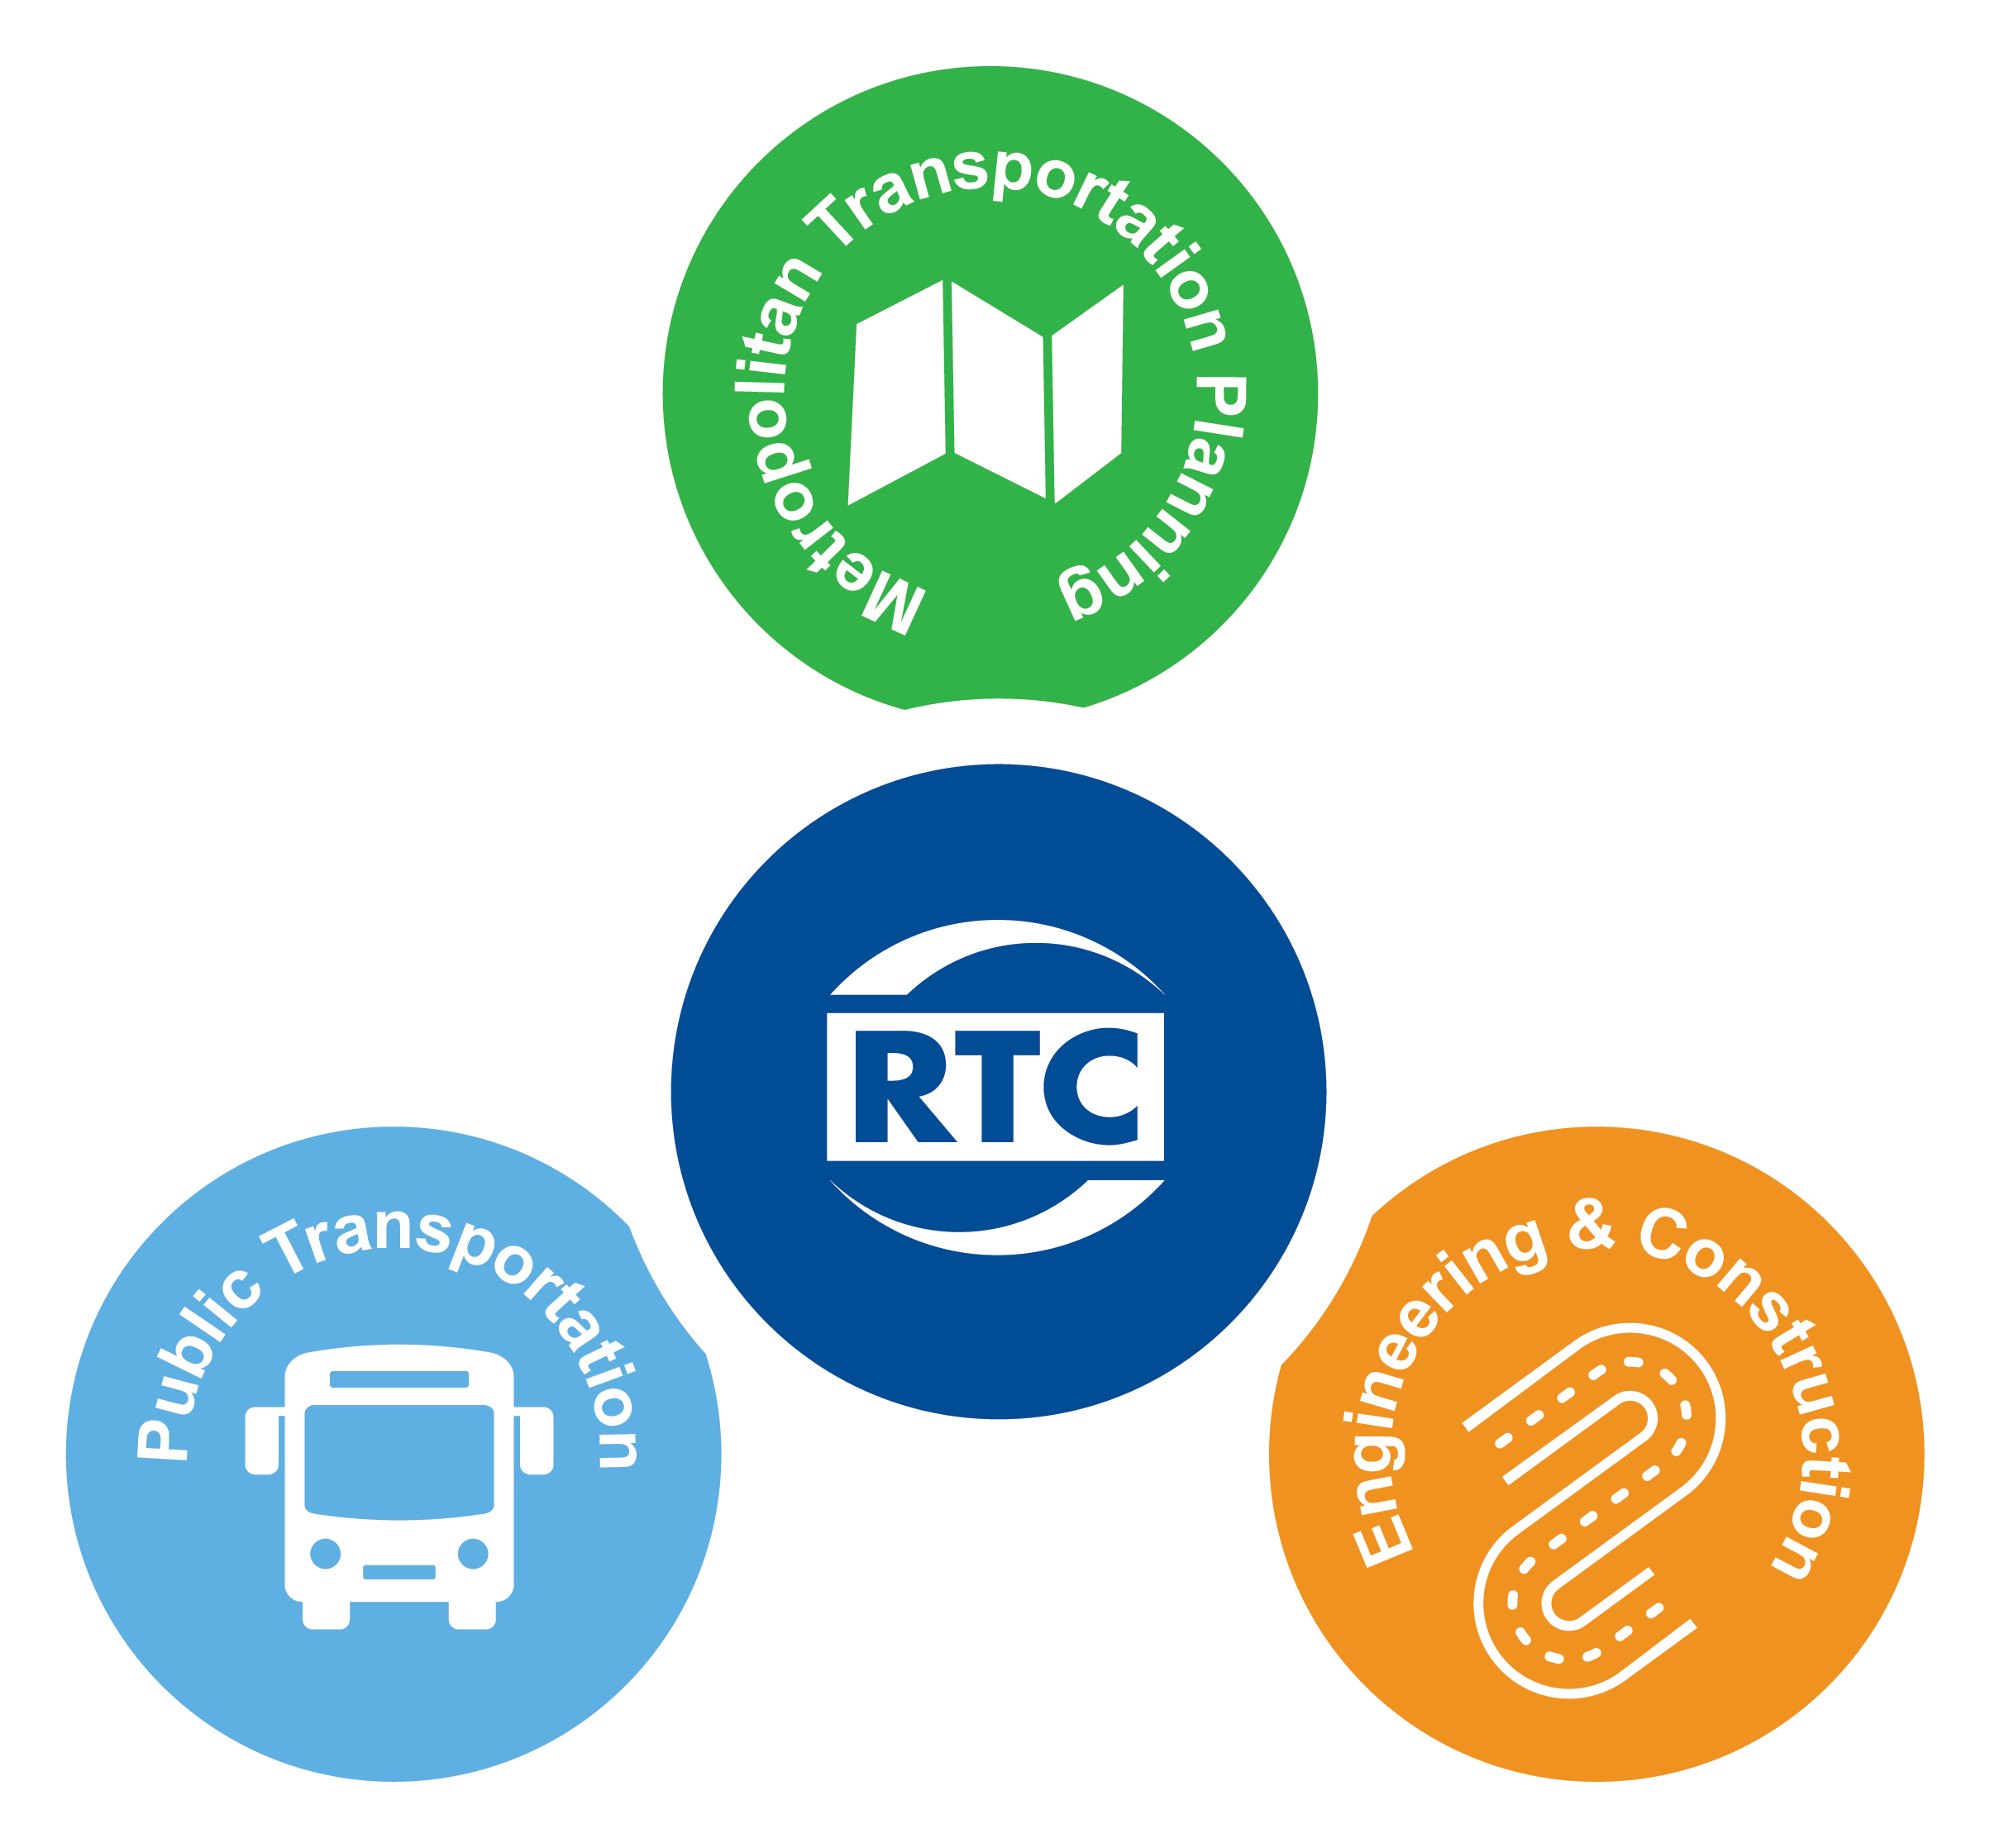
REGIONAL TRANSPORTATION COMMISSION
of WASHOE COUNTY
UPDATE
MAY 2024

Slide 2

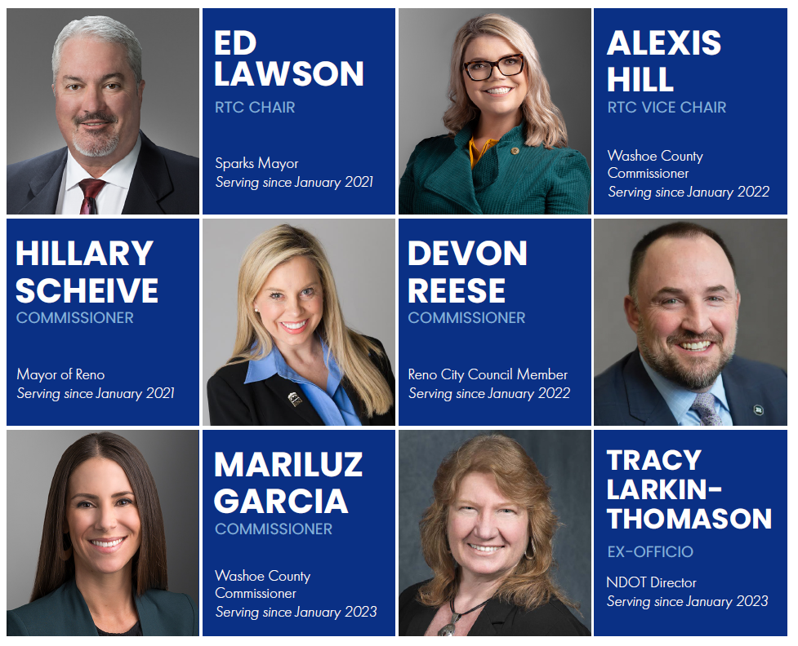

Slide 3
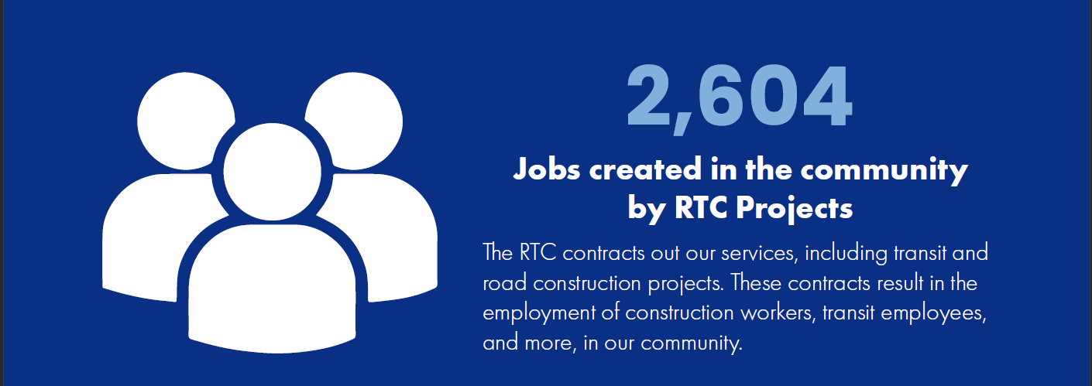
Jobs created
2023 ANNUAL REPORT

Slide 4
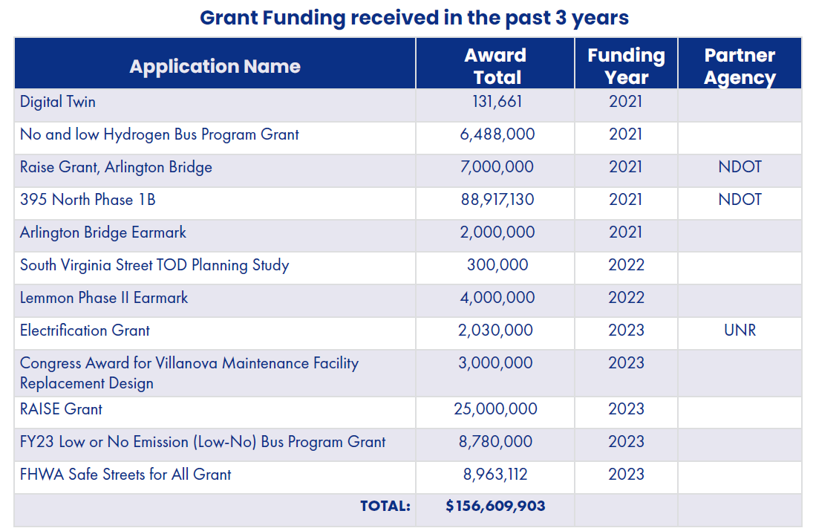
2023 ANNUAL REPORT

Slide 5
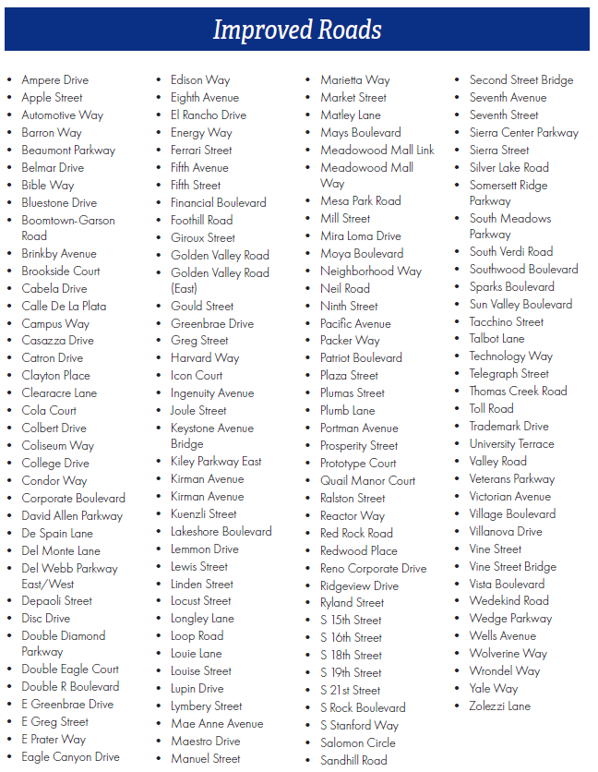
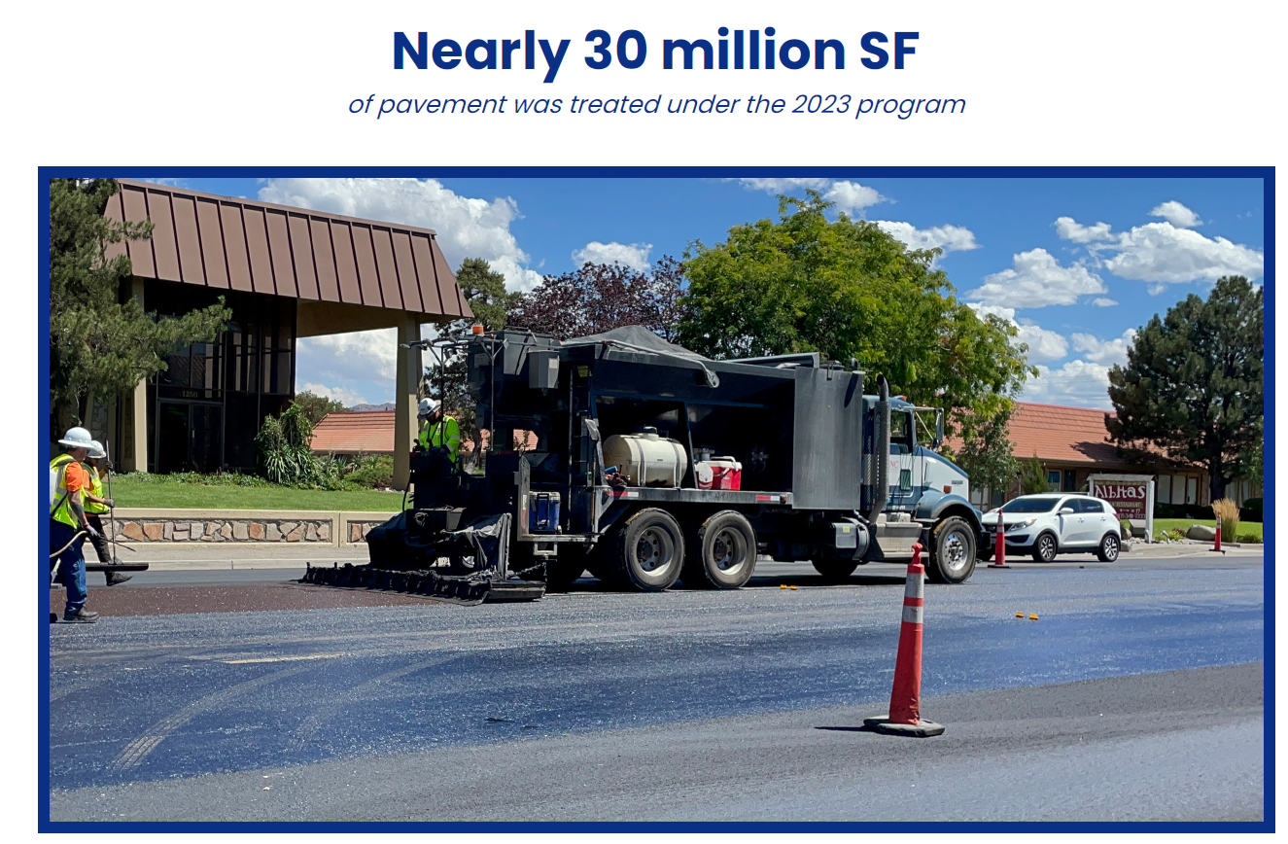
2023 ANNUAL REPORT

Slide 6
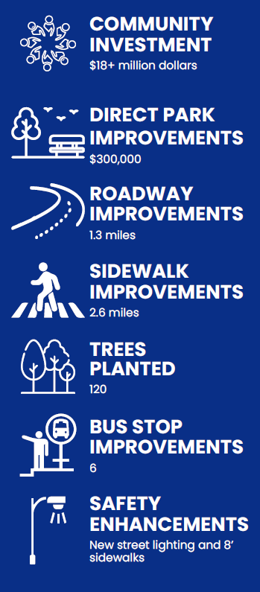
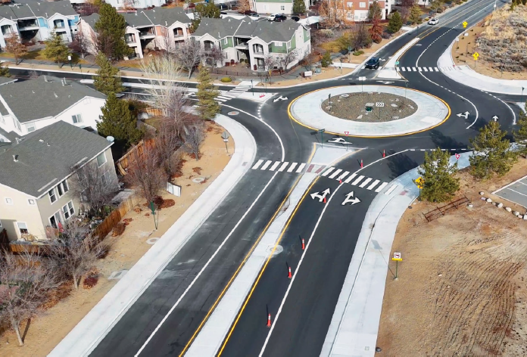
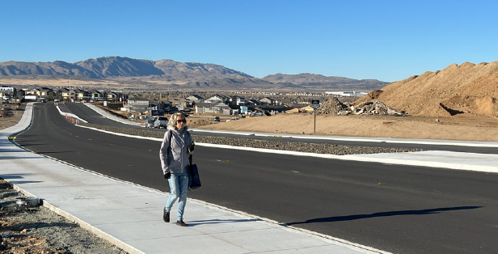

COMPLETED PROJECTS
4TH ST. / WOODLAND AVE ROUNDABOUT
SKY VISTA PARKWAY WIDENING PROJECT

Slide 7
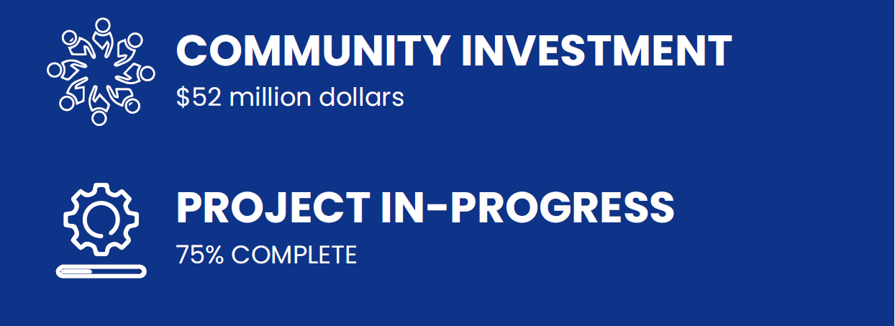
CURRENT CONSTRUCTION PROJECTS
2024 CONSTRUCTION PROJECTS
1st Street Rehab
2024 Preventive Maintenance Project
Kietzke Lane Fiber
Las Brisas Blvd / Los Altos Blvd Corrective
N. McCarran Blvd / Pyramid Hwy Fiber
N. Virginia St University Rehab
Raleigh Heights Rehab
Selmi Drive Rehab
S. Virginia St / In-n-out Improvements
Somersett Pkwy Corrective
South Meadows Traffic
Sparks Intelligent Corridor
Stanford Way Rehab
Traffic Signal Installations
Traffic Signal Modifications
Veterans Roundabout Modifications
Steamboat Pkwy Improvements
Vista Blvd / Prater Way Fiber

Slide 8
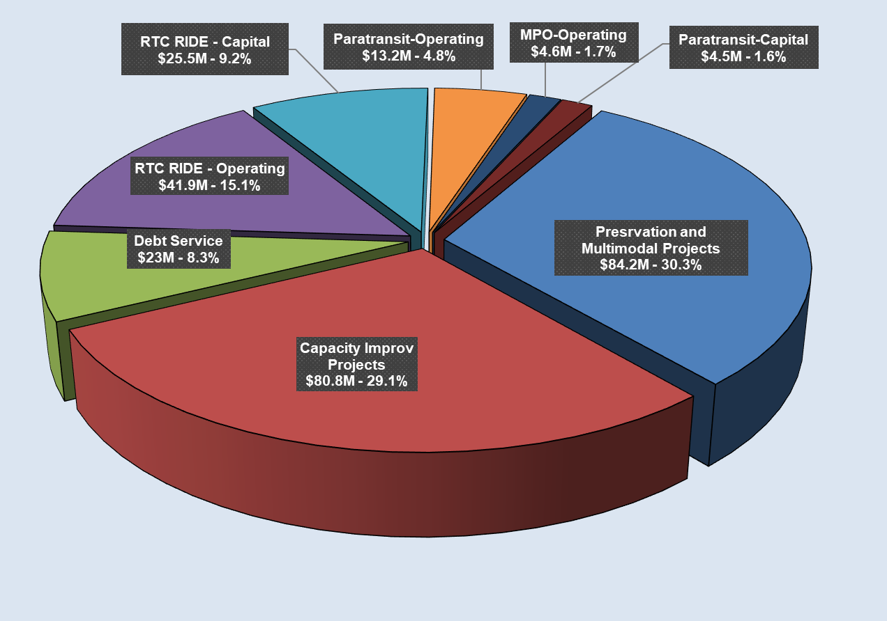
FY25 Revenues & Expenditures
FY25 Projected Revenues
  $251,445,002
FY25 Tentative Budget
  $290,175,657

Slide 9


Slide 10
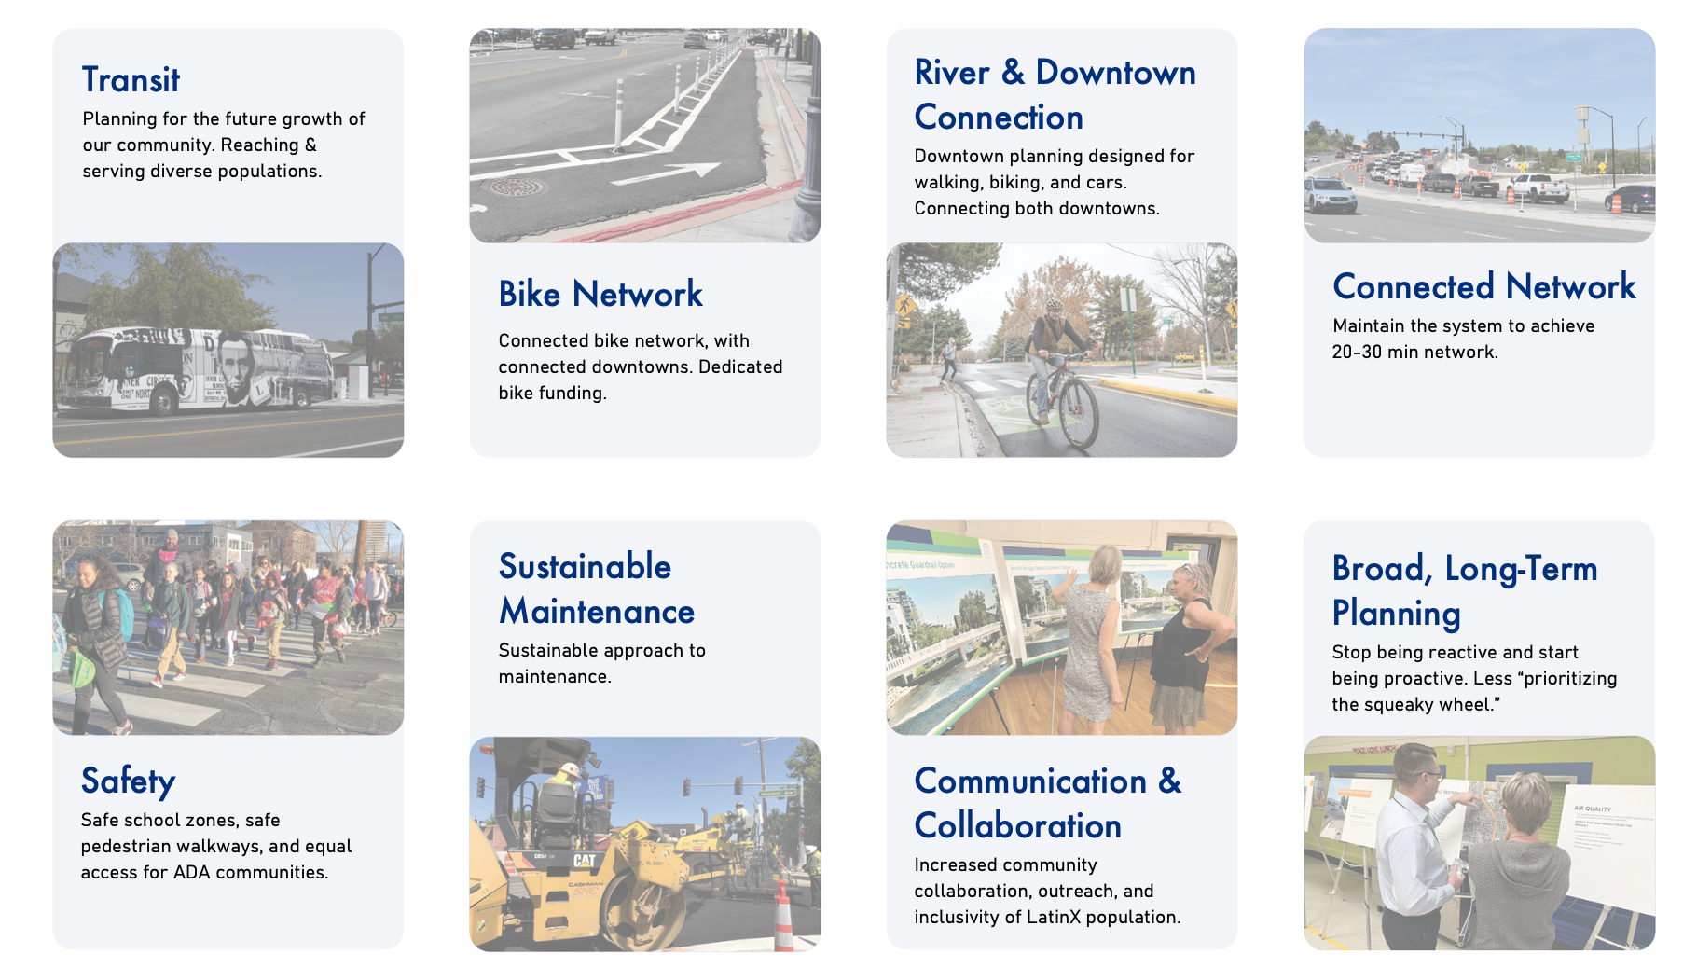
VISION BOARD

Slide 11

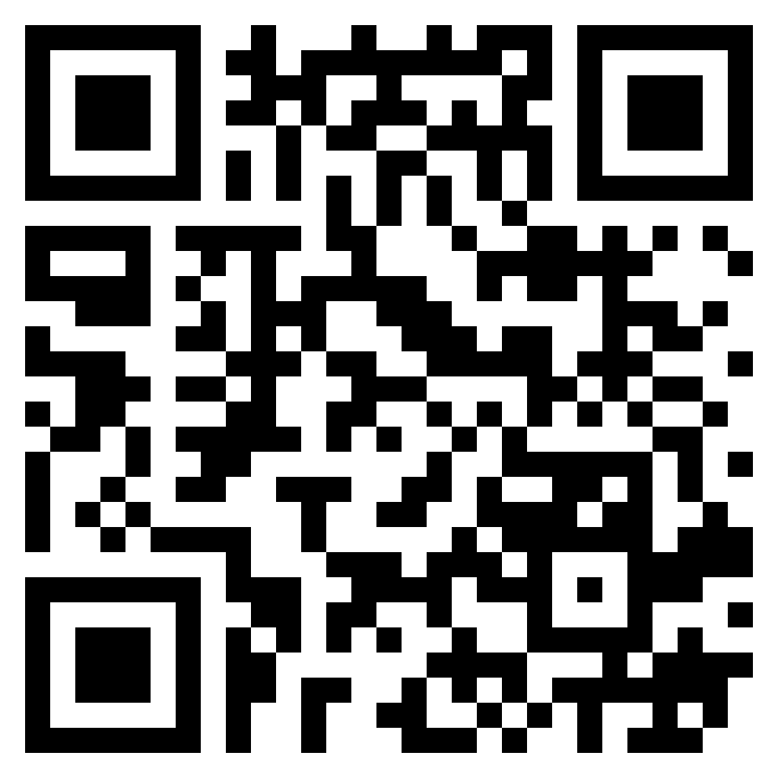
RTP PURPOSE & GOALS
Identify the transportation goals & principles that direct regional transportation investments through 2050
Plan completion by March 2025
Federally required for MPOs (23 CFR § 450.324)
Get Involved:

Slide 12
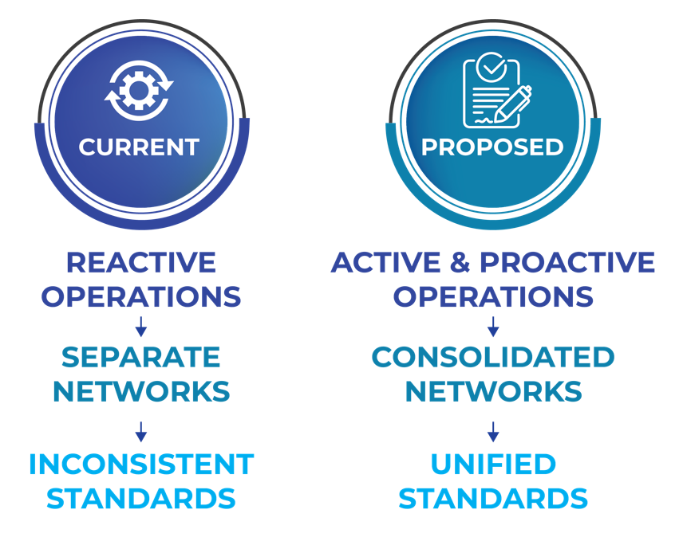
REGIONALIZE TRAFFIC OPERATIONS

Slide 13
CHALLENGES & OPPORTUNITIES
Resources
Focused approached
Transit sprawl
Federal regulations and permitting
Bipartisan Infrastructure Law expires Sept. 2026
Sustainable funding
RTC Street & Highways Qualified List - 2025
  Engineering / Traffic / Construction Management
Leveraging resources with partner agencies
Continued transportation investment
Focused outcomes
  Pavement / Operations / Active Transportation / Safety

